Slide 1
Git – An Introduction
Moritz Flüchter

Slide 2
Content of Workshop
Why use GIT?
What is GIT?
Using GIT

Slide 3
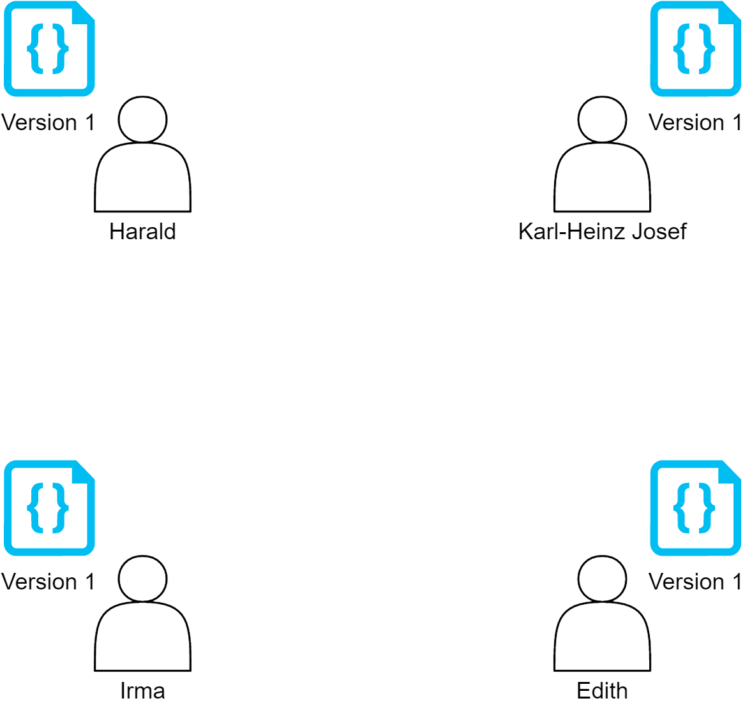
Why should you use Git? – A Counterexample

Slide 4
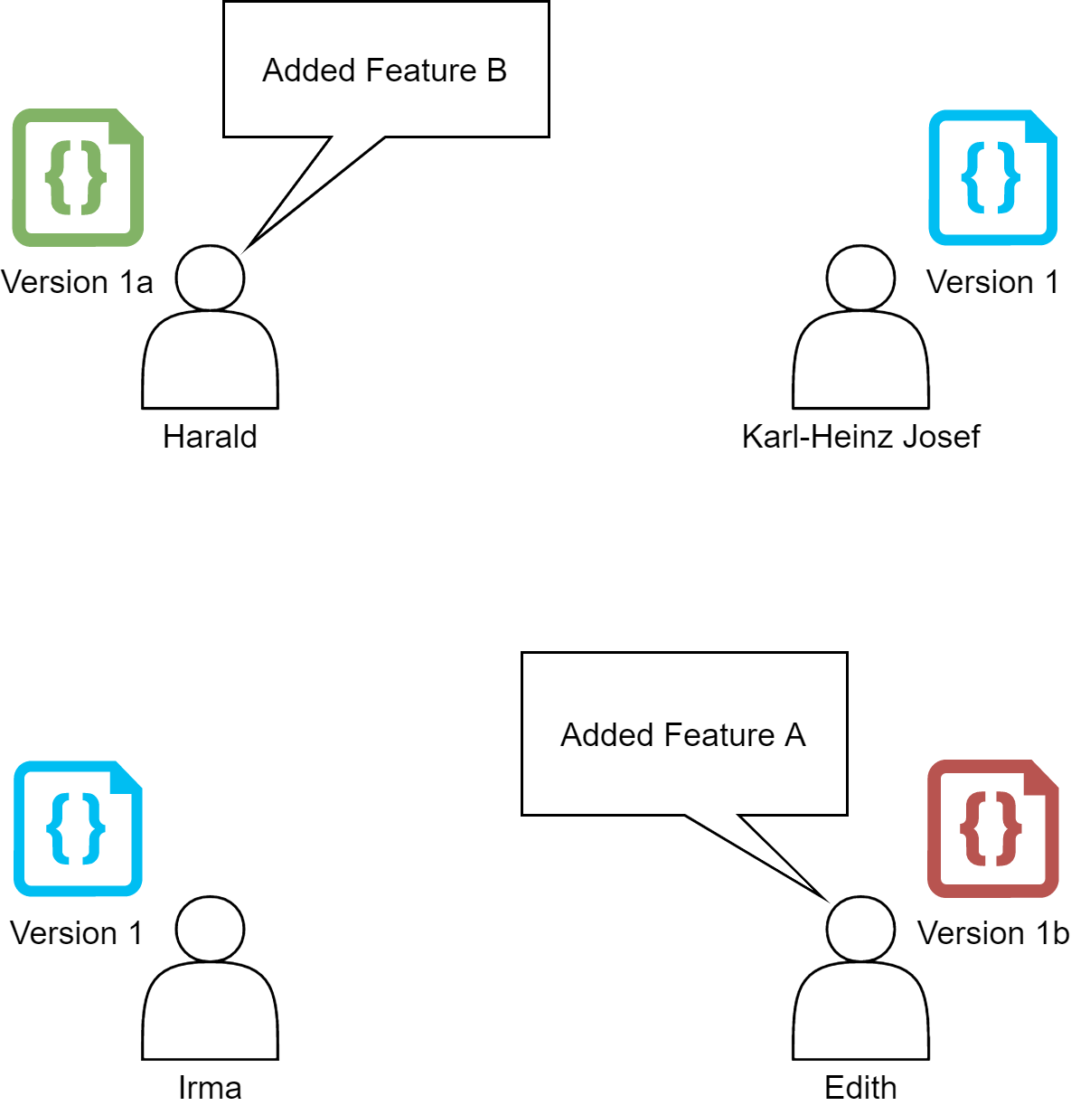
Why should you use Git? – A Counterexample

Slide 5
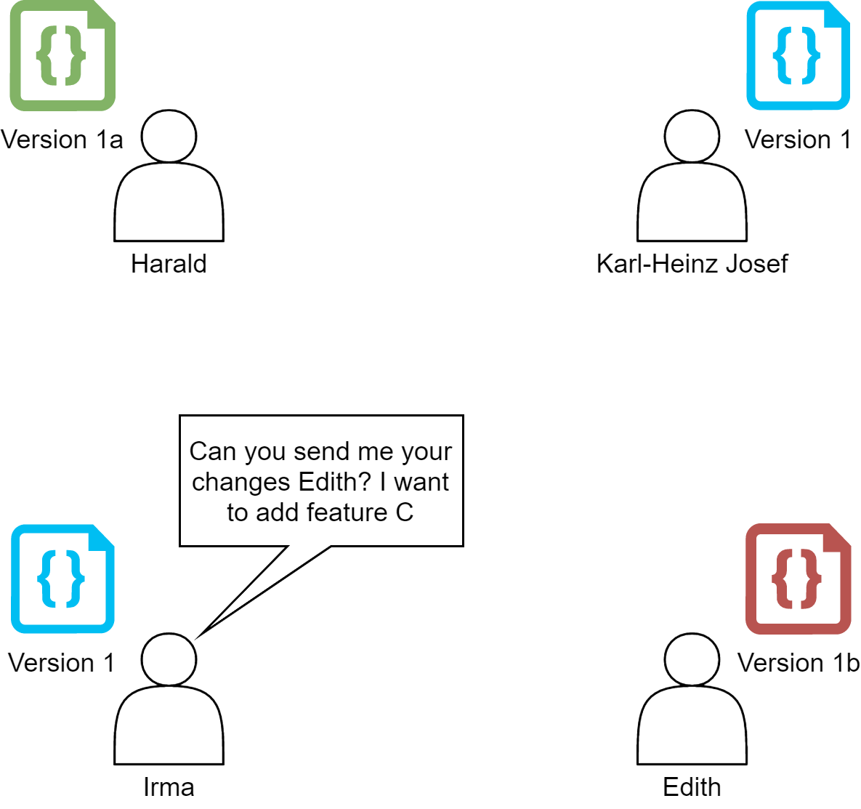
Why should you use Git? – A Counterexample

Slide 6
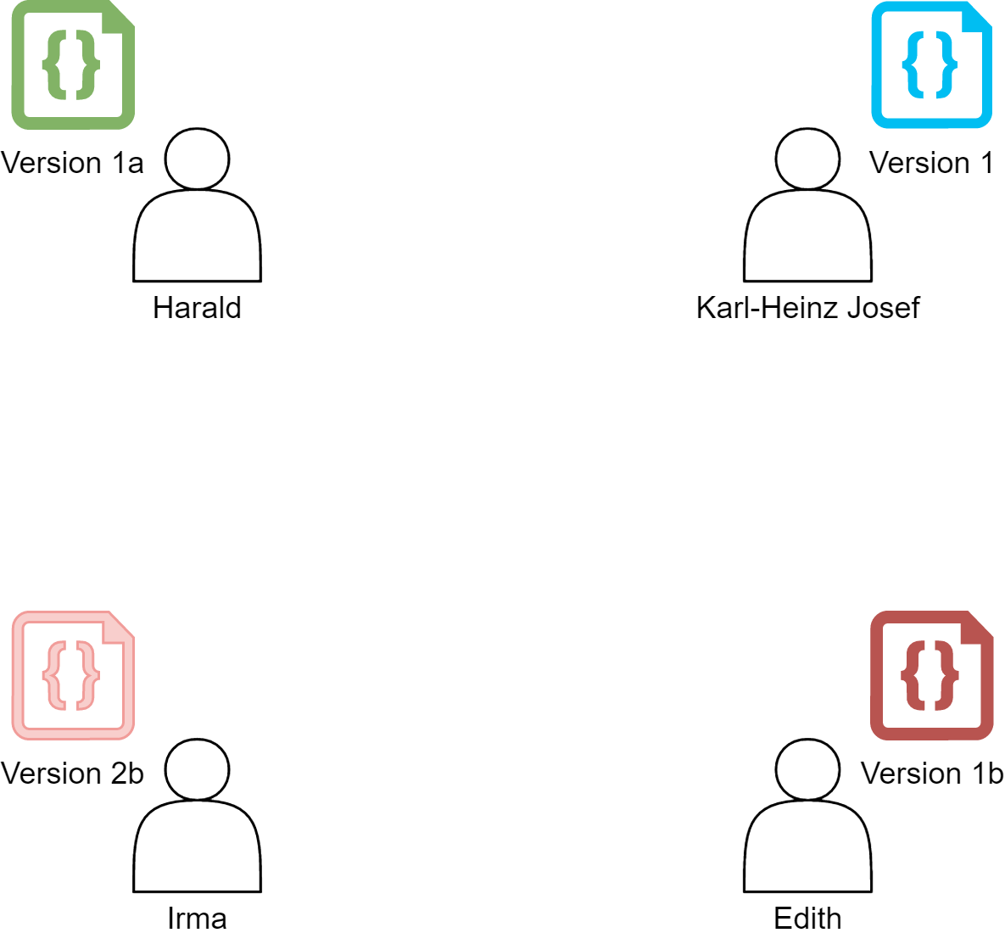
Why should you use Git? – A Counterexample

Slide 7
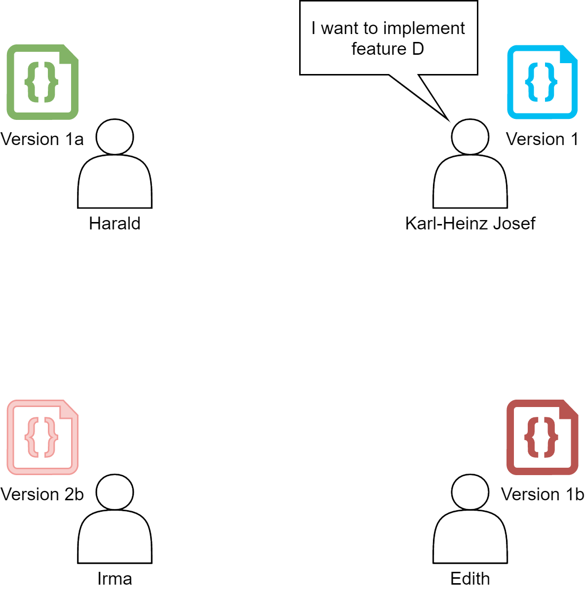
Why should you use Git? – A Counterexample
Who sends the code?

Slide 8
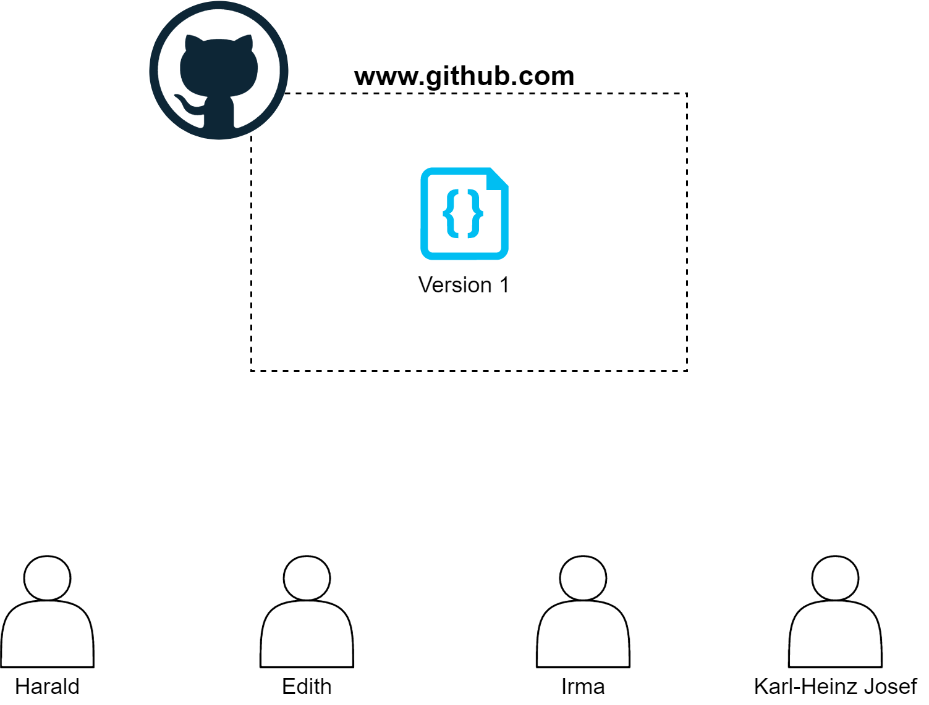
Why you should use Git!

Slide 9
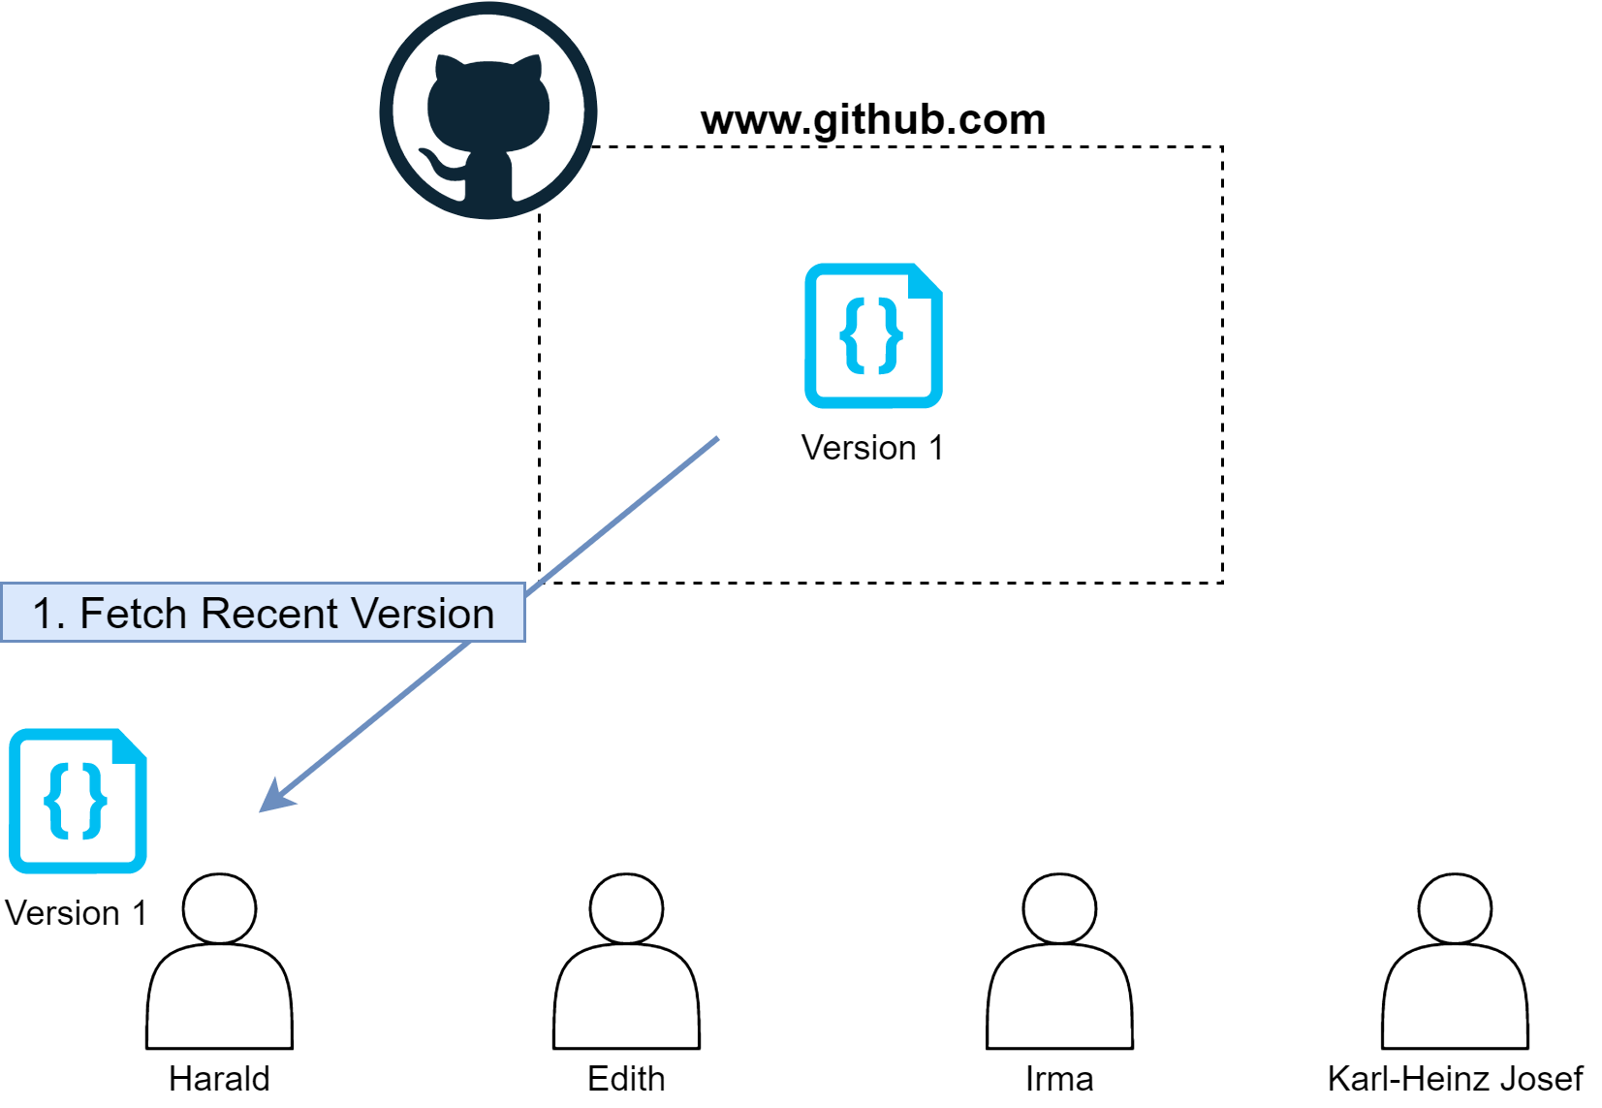
Why you should use Git!

Slide 10
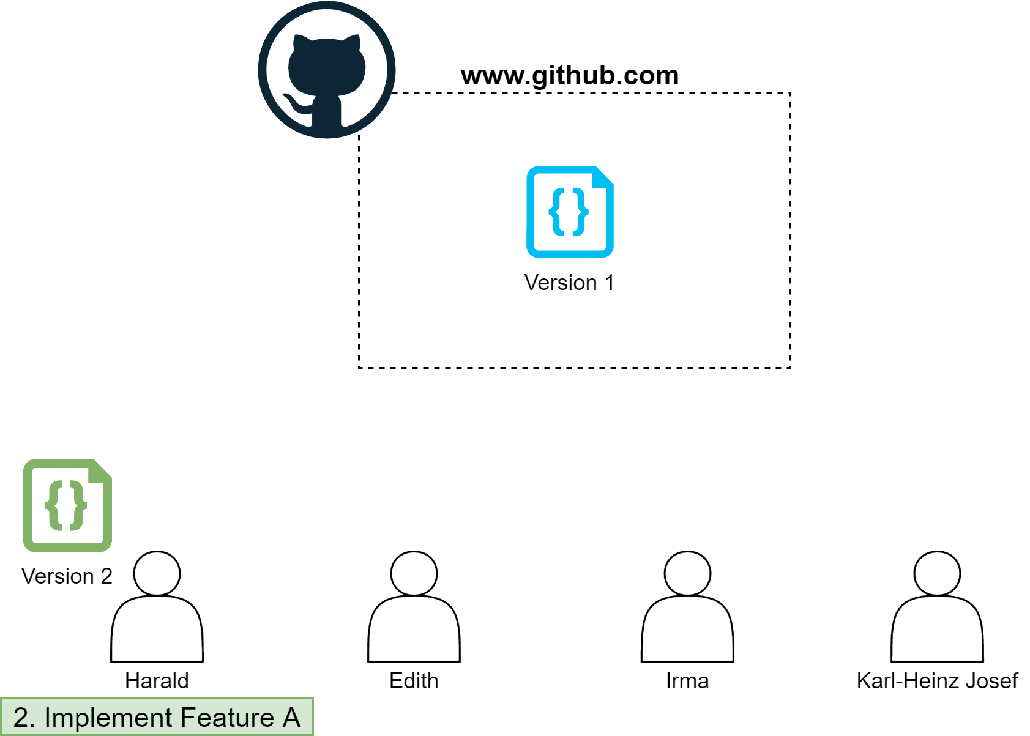
Why you should use Git!

Slide 11
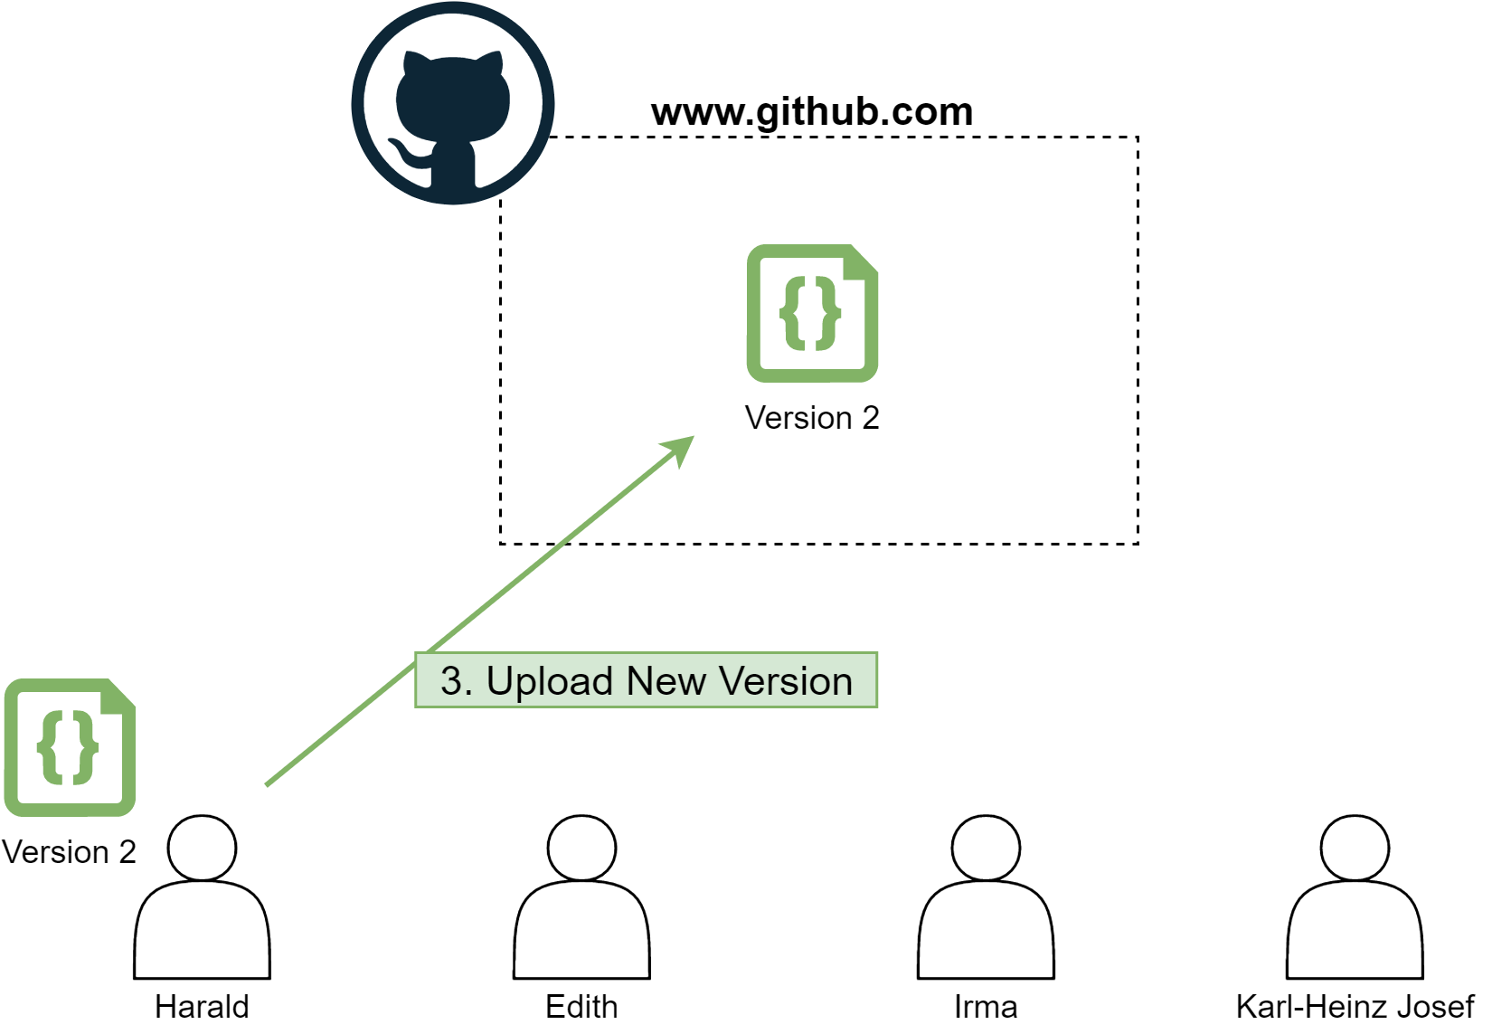
Why you should use Git!

Slide 12
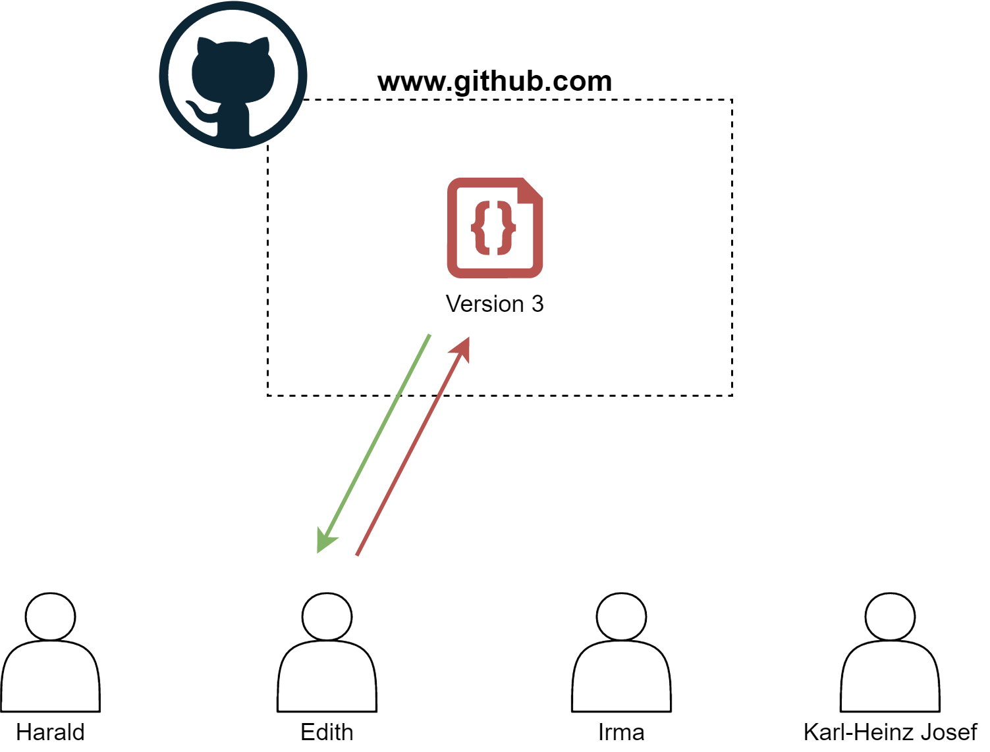
Why you should use Git!

Slide 13
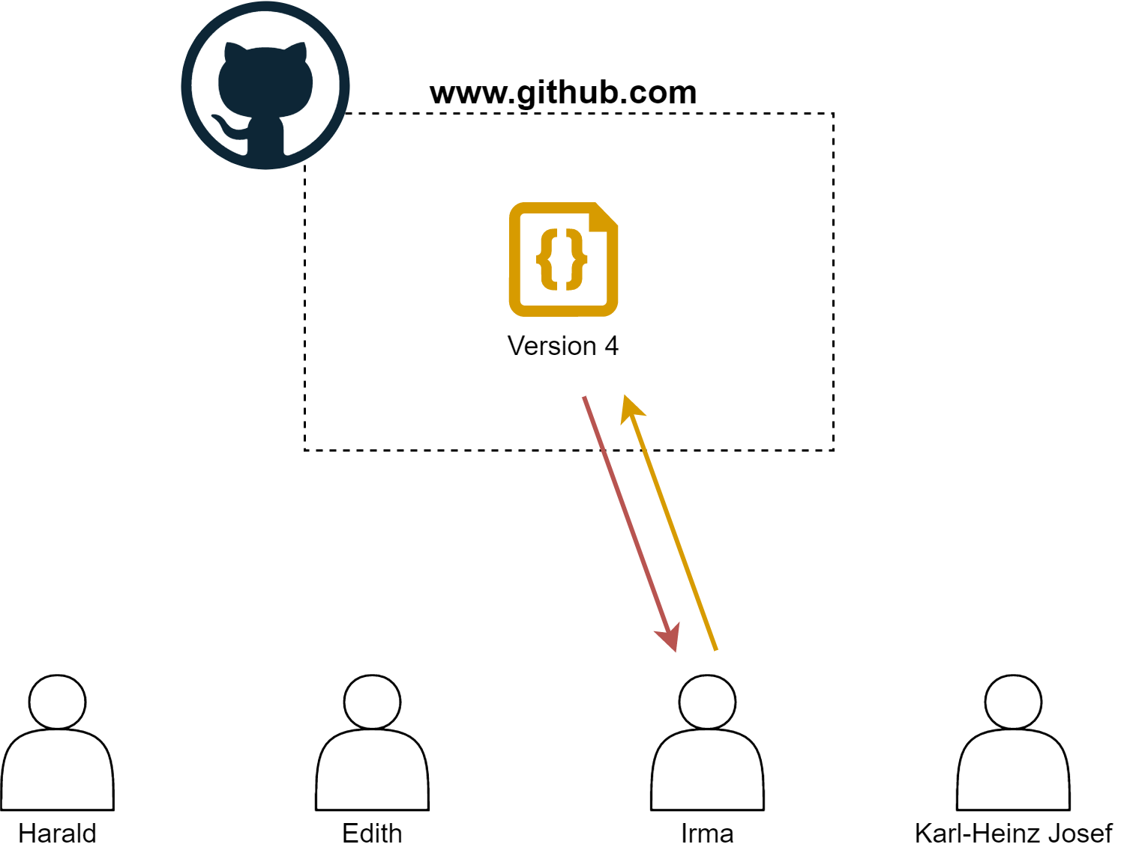
Why you should use Git!

Slide 14
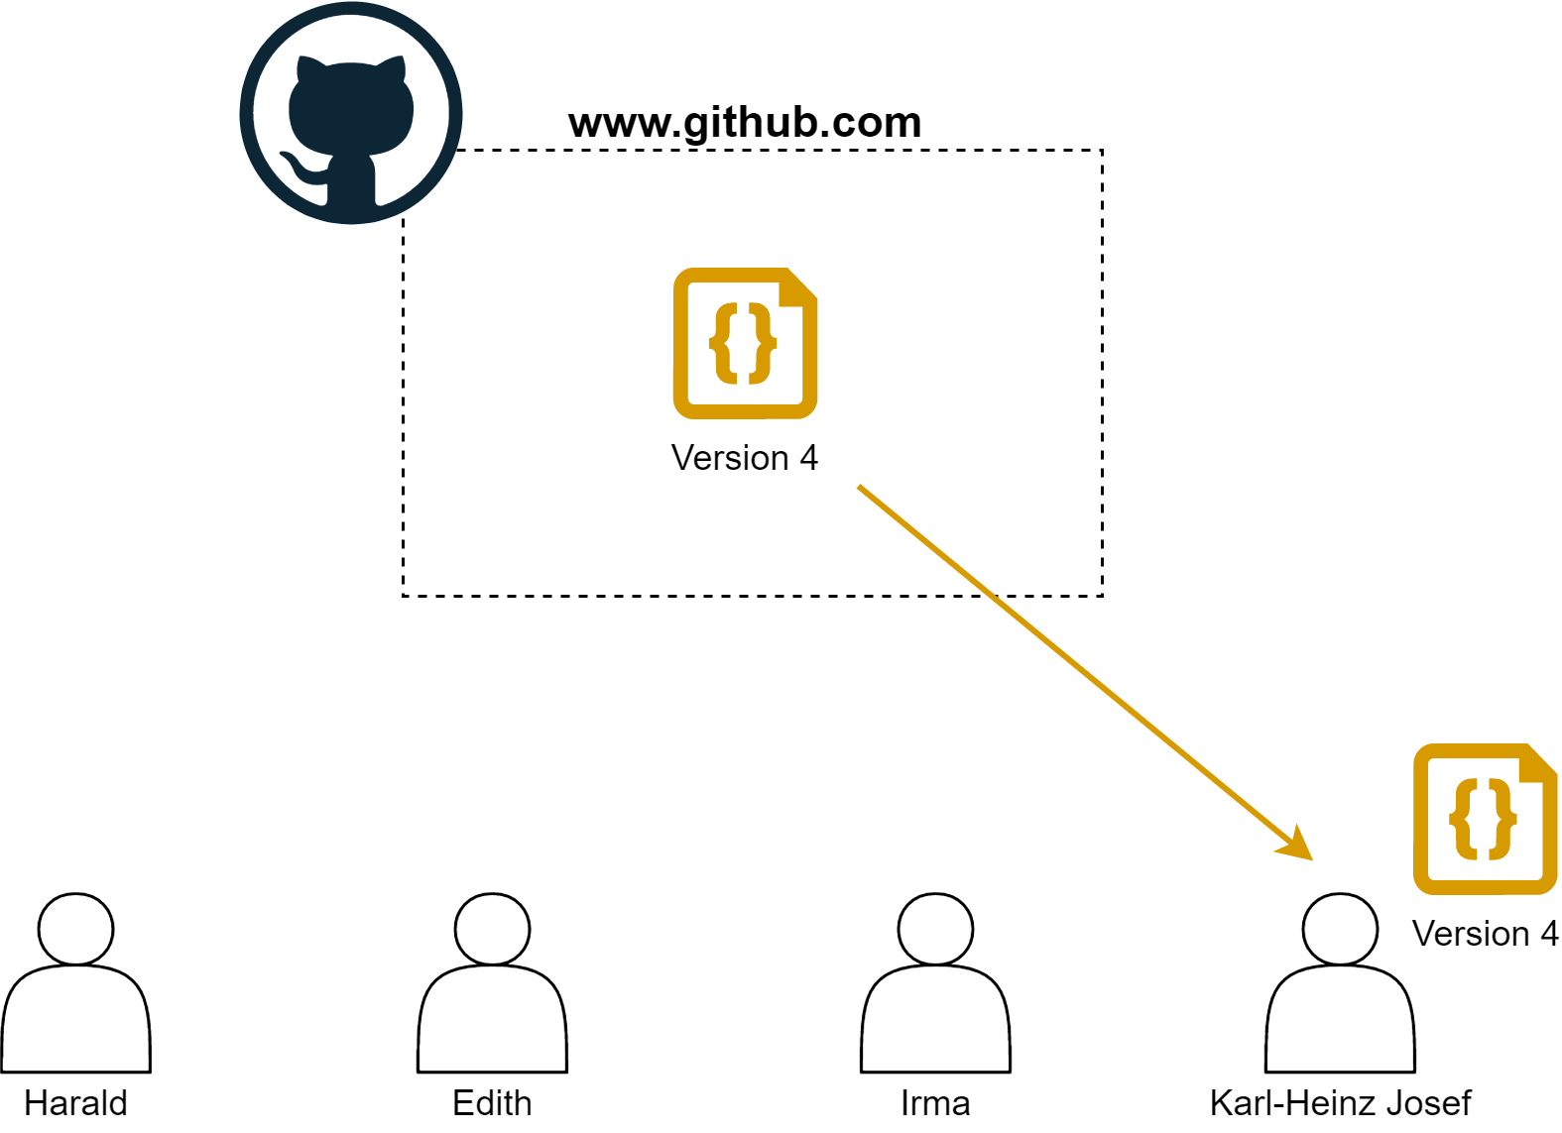
Why you should use Git!

Slide 15
Git VS GitHub
Git:
Tool that tracks local changes
Manages down-/upload of files
Handles conflicts
Many more features
GitHub:
Server that stores the files
Git

Slide 16
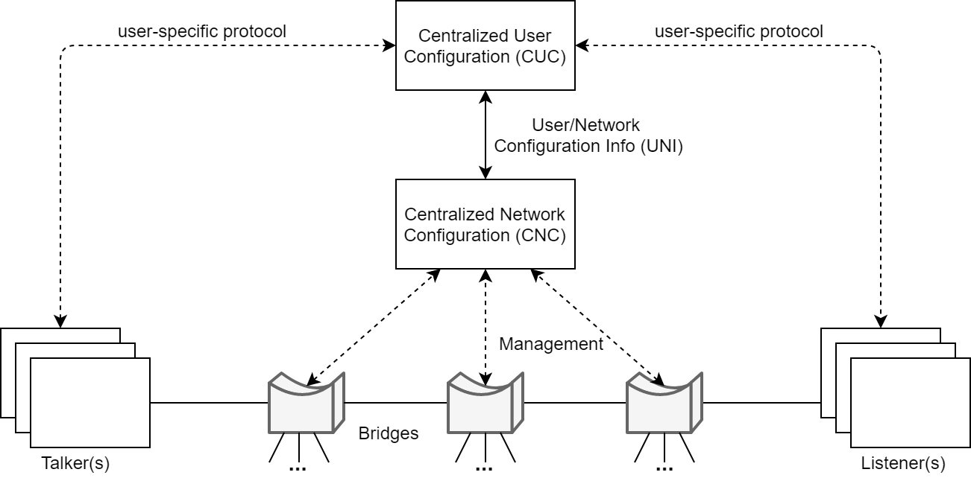
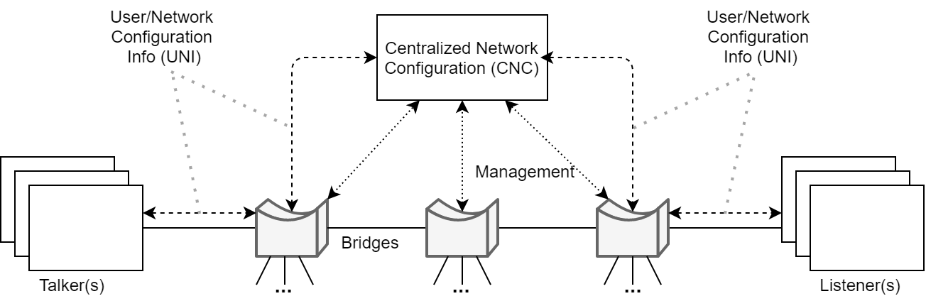
COMPARISON/2 TOPICS
HEADING 1
HEADING 2
TEXT
TEXT

Slide 17
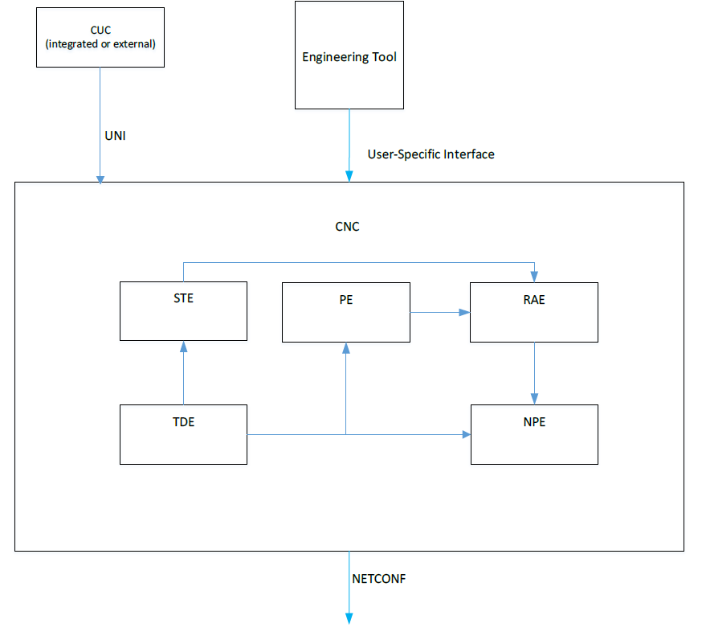
TEXT + IMAGE
HEADING
TEXT

Slide 18
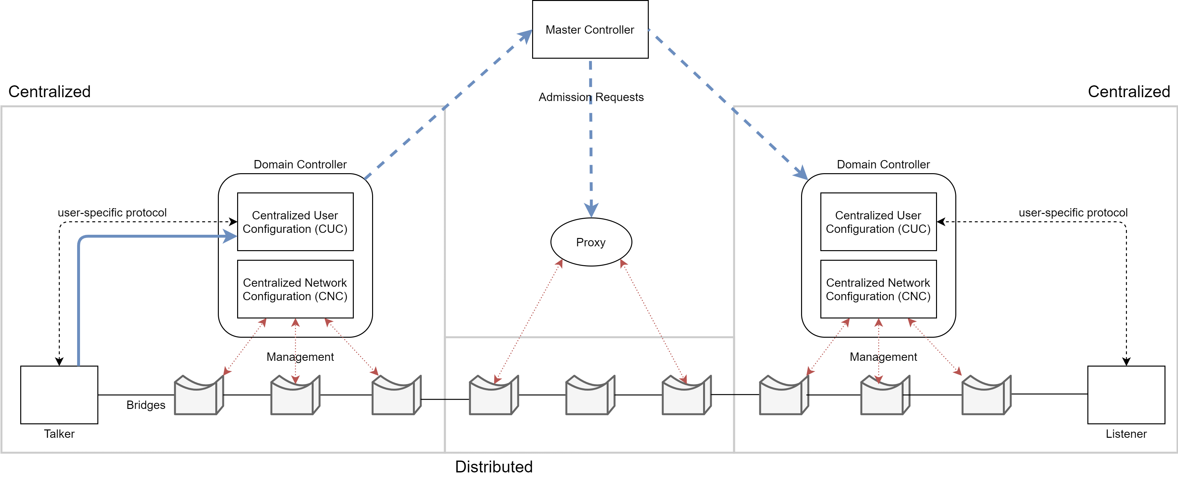
TEXT BELOW IMAGE
HEADING
TEXT

